Slide 1
Northwell Health
  IRB 101
Hallie Kassan, MS, CIP, Director
Office of the Human Research Protection Program
Notes:
IRB and ORC 2 halves of whole

Slide 2
Learning Objectives
Identify the ethical cases which led to the creation of the Human Subject Protection Program
Understand and apply the three main principles of the Belmont Report
Understand the federal regulatory definition of which activities are considered research
Understand the federal regulatory definition of research that includes the use of human subjects

Slide 3
Learning Objectives
Understand the federal regulatory definition of minimal risk
Understand the functions of an Institutional Review Board
Understand when an exemption from review by the IRB is permissible

Slide 4
Learning Objectives
Understand the ethical considerations of study design
Understand the importance of clinical equipoise
Understand the role of analysis of risks and benefits in the ethical conduct of research
Understand the impact of therapeutic misconception

Slide 5
Human Research Protection Program
Office of Research
Compliance (ORC)
Office of the
Human Research Protection Program (HRPP)
The ORC and HRPP work together to protect the rights, welfare and privacy of research participants

Slide 6
Human Research Protection Program
Office of Research Compliance (ORC)
Education and training
On-going audits for Good Clinical Practice (GCP)
Respond to allegations or audit findings of improper/illegal activities and enforcement of disciplinary action for violations
Regulatory support for investigator-initiated studies
Notes:
Anonymous hotline to receive concerns; review allegations of research non-compliance

Slide 7
Human Research Protection Program
Office of the Human Research Protection Program (OHRPP)
Administration of the Northwell Health Institutional Review Board responsible for the oversight of human subjects research
Guidance and support to investigators who plan to conduct clinical research projects
Development of policies and procedures to assure compliance with institutional and governmental regulations
Review and approve all human subjects research
Notes:
Provides education
Creates policy
Oversees two committees that review and approve human subjects
Pre-submission help
Can provide education and training.

Slide 9
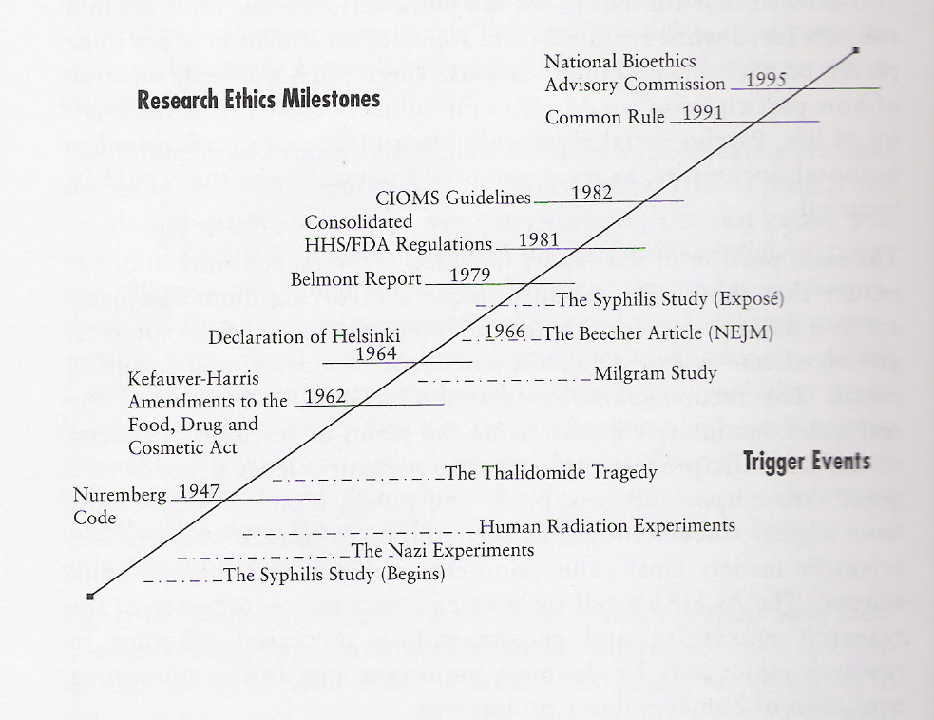
Where Did the Research Regulations Come From?
(From Dunn and Chadwick, 1999)

Slide 10
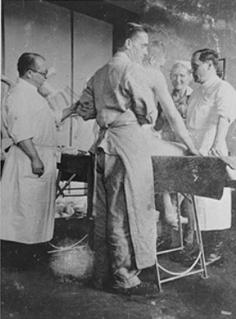
Nazi Atrocities
Human Experimentation in Concentration Camps
Freezing Experiments
Typhus Infections
Twin Experiments

Slide 11

Nuremberg Trial
In 1946-47, the Nuremberg Military Tribunal uncovered the atrocities of Nazi human research.
Nazis who conducted these experiments on prisoners in Concentration Camps, were tried for War Crimes and Crimes Against Humanity.

Slide 12
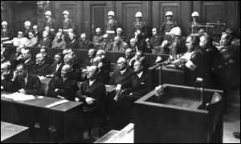
Nuremberg Code
Voluntary consent
Sound study rationale – sound scientific basis, and for good of society
Risk/Benefit – avoid suffering
Protect human subjects
Notes:
Represents the starting point in the modern era of human subjects protections
Informed consent is essential.
Research on human subjects should be based on prior animal work.
The risks should be justified by the anticipated benefits.
Only qualified scientists should be allowed to conduct research with human subjects.
Physical and mental suffering must be avoided.
Research in which death or disabling injury is expected should not be conducted
Code does not consider issues relevant to SBER research

Slide 13
Nuremberg Code
Generally held as the first international ethical code for the protection of human research subjects.
Not widely distributed or followed throughout the world.
The Nuremberg Code was believed to apply to the Nazi doctors, not to other researchers.
Abuses of human subjects continued to occur in the 1940’s-1960’s.

Slide 14
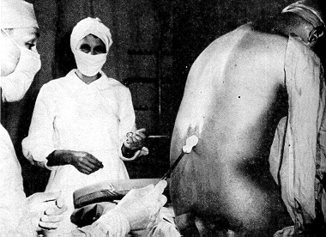
U.S. Public Health Service Study of
Untreated Syphilis at Tuskegee 1932-1972
Subjects were 600 Black men
Promised free transportation to and from hospitals, free hot lunches, free medical care for diseases other than syphilis, and free burial after autopsies were performed.
Never informed that they were research subjects, or that treatment for their syphilis could have been provided.
Told they had “bad blood”, and required periodic medical examinations, including spinal taps.
Notes:
The next event went on for over 40 years.
American medical research project conducted by the U.S. Public Health Service from 1932 to 1972, examined the natural course of untreated syphilis in black American men.
The subjects, all impoverished sharecroppers from Macon County, Alabama, were unknowing participants in the study; they were not told that they had syphilis, nor were they offered effective treatment.

Slide 15
Tuskegee Syphilis Experiment
Subjects were not offered information regarding the available treatment, and were actively prevented from seeking it elsewhere.
Some subjects died of the disease, passed it on to wives, or passed congenital syphilis to children.
Notes:
The idea was to get a clear observational picture of the natural progression of the disease. Subjects had to agree to an autopsy by investigators in order to have their funerals paid for. Many subjects were lied to and given placebo treatments.
By the end of the study in 1972, only 74 of the test subjects were alive. Twenty-eight of the original 399 men had died of syphilis, 100 were dead of related complications, 40 of their wives had been infected, and 19 of their children were born with congenital syphilis.

Slide 16

Study of Untreated Syphilis in Negro Males
  Resulted in passage of the National Research Act (1974)
- Established the National Commission for the Protection of Human Subjects of Biomedical and Behavioral Research
Belmont Report (ethical principles)
DHHS & FDA Regulations
Notes:
As a result of this study the National Research Act was passed. It included regulations for the protection of human subjects, with added standards for consent and IRBs. This led to the National Commission, which issued the Belmont Report. (Why Belmont??)
The Belmont Report is the cornerstone of ethical principles for the conduct of research involving human subjects.
There is a copy of it in your packet. And we urge you to read it.

Slide 17
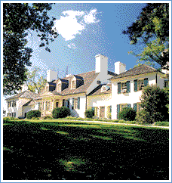
National Research Act of 1974

Slide 18
National Research Act of 1974
On July 12, 1974, the National Research Act was signed into law, there-by creating the National Commission for the Protection of Human Subjects of Biomedical and Behavioral Research.
The NRA also mandated the creation of Institutional Review Boards (IRB’s) for all research that receives direct or indirect funding from the Department of Health and Human Services.

Slide 19
Belmont Report
Differences between Research and Clinical Practice
Identified basic ethical principles which underlie the ethical conduct of research involving human subjects
  Respect for persons.
  Beneficence.
  Justice.
Notes:
One of the charges to the Commission was to identify the basic ethical principles that should underlie the conduct of biomedical and behavioral research involving human subjects and to develop guidelines which should be followed to assure that such research is conducted in accordance with those principles. (see The Belmont Report)

Slide 20
Boundaries Between Research & Practice
Practice: interventions that are designed solely to enhance the well-being of a client and have a reasonable expectation of success.
Research: Activity designed to test a hypothesis, permit conclusions to be drawn, contribute to generalizable knowledge.
Research and Practice can be done together, but there is a Potential Conflict:
  When a subject’s participation may place him/her at risk of harm.

Slide 21
Respect for Persons = Informed Consent
  1. Informed Choice
    Acknowledges the freedom and dignity of every person.
    People should be able to choose what shall and shall not happen to them.
    Requires obtaining informed consent from all potential research subjects.
Notes:
Subjects should enter research freely and with adequate information.

Slide 22
Respect for Persons
  2. Persons with diminished ability to consent are entitled to protection.
    The extent of protection required depends on the risk of harm and the likelihood of benefit.
    Even these persons should be informed about the study, and assent to the extent possible.
  3. That true informed consent has been obtained is the responsibility of the investigator.

Slide 23
Beneficence = Risks and Benefits
  1. Do no harm
          One should not injure a person despite possible benefits to others (society).
          Risks to subjects should be minimized.
  2. Maximize Benefits/Minimize Harms
    Beneficence recognizes the long-term benefits that arise from improving knowledge and medical care.
Notes:
Examples – have blood draws when subjects are having blood drawn for clinical purposes.
Take extra Bone marrow when bone marrow biopsies are being done for clinical purposes.

Slide 24
Justice = Enrollment
  Justice requires equitable selection, recruitment, and fair treatment of research subjects.
    Subjects should not be selected because of easy availability or vulnerability.
    Research should not provide benefits only to those who can afford them.
    Research should not unduly involve subjects from groups unlikely to benefit from such research.
    Groups of subjects should only be included or excluded from research for scientific reasons.
Notes:
Equitable distribution of research risks and benefits
Regulations require equitable selection of subjects for research.
Examples – research on mexicans who have diabetes prevalent
Research about benefits – aids research in africa – but will this population ever receive benefits of the approved drugs.

Slide 25
How did the Tuskegee Study violate these principles?
Respect for Persons
No informed consent process.
Deception – participants were told that non-therapeutic
spinal taps were “treatment” for “bad blood”.
Beneficence
Withholding effective treatment.
Lack of meaningful and effective continuing review.
Justice
Vulnerable population was used.
Notes:
Let’s look at the Syphillis study to see how all three of these principles were violated.
There was no informed consent process.
Subjects were deceived.
Treatment was withheld.
There was no continuing review.
And an extremely vulnerable population was used.
STOP HERE
Don’t read -How about a more recent example – The University of South Florida and Tampa General Hospital agree to a 3.8 million dollar lawsuit over the informed consent document in a clinical research study. In this study involving pregnant women, patients were not fully informed of the risks and alternatives to participation, consent forms were too difficult to understand, pts. were enrolled while they were in labor. Even though the research was not risky, no ae were documented, the harm was “dignitary harm” due to failure of the informed consent process, which violated the “respect for persons” principle. Their autonomy was not respected. That was it. The case was settled for 3.8 million.

Slide 26
More Current Research Climate
Jesse Gelsinger
Facebook Research Study
SUPPORT Study
Notes:
There is still controversy surrounding human subjects research today. In 1999, an 18 year old boy was entered onto a gene therapy study at U Penn. He died four days later. FDA determined that he was enrolled despite having high ammonia levels that should have led to his exclusion from the trial, Failure by the university to report that two patients had experienced serious side effects from the gene therapy and Failure to disclose, in the informed-consent documentation, the deaths of monkeys given a similar treatment.

Slide 27
How do we go about protecting human subjects?

Slide 28
Federalwide Assurance (FWA)
Formal agreement between Northwell and the DHHS OHRP
  -Documentation of commitment to operate in compliance with the federal regulations governing research with human subjects
  -Statement of commitment to conduct research within the ethical standards outlined in the Belmont Report
  -Applies to all research involving human subjects regardless of source of funding or support conducted at Northwell, as well as to research conducted elsewhere by physicians, students, staff, or other representatives of Northwell Health in connection with their institutional responsibilities
Notes:
This is a signed document sent to OHRP which indicates that as a health system, we
comply with all federal regulations that apply to human subject research. We agree to
follow the principles of the Belmont Report that Hallie went over with you earlier.
These federal regulations apply to all research conducted at NSLIJHS or in connection
with anyone acting as agents of this institution elsewhere.

Slide 29
What is an IRB?
An IRB is a committee whose sole mission is to protect human subjects who participate in research.
IRB’s are federally mandated for any institution that receives, directly or indirectly, federal money for research.
IRB’s have the power to approve, disapprove, or require modifications prior to approval for any proposed research

Slide 30
45 CFR 46 – The Common Rule
Protection of Human Subjects
Outlines criteria for approval of research and requirements for the informed consent process
Defines special requirements for vulnerable populations
Defines composition of IRB Committee
http://www.hhs.gov/ohrp/humansubjects/guidance/45cfr46.htm
Notes:
The Common Rule consists of regulations governing IRBs for oversight of human
research. The Common Rule came into effect in 1981 and outlines criteria used for the
approval of research, informed consent process requirements as well as special
requirements for vulnerable populations (such as children and prisoners)
The Common Rule also defines the composition of IRB Committees as well as IRB
functions and operations

Slide 31
FDA regulations
21 CFR 50 - Protection of Human Subjects
21 CFR 56 - Institutional Review Boards
21 CFR 312 – Investigational New Drug Application
21 CFR 812 – Investigational Device Exemptions
www.fda.gov
Notes:
Most of the FDA regulations are very similar to the Common Rule. There are a few
differences that we will not go into here. Title 21 is the portion of the CFR that governs food and drugs within the US for the (FDA), the Drug Enforcement Agency (DEA),
and the Office of National Drug Control Policy (ONDCP). It is important to note that
research involving drugs, biologics or medical devices is subject to appropriate FDA
regulations. These regulations are based on the Federal, Food, Drug and Cosmetic Act.
An Advance Notice of Proposed Rulemaking has been issued in July which hopefully will address some of these differences.

Slide 32
HIPAA
45 CFR 164
IRB serves as the privacy board to assure research studies are in compliance with HIPAA regulations
http://www.access.gpo.gov/nara/cfr/waisidx_07/45cfr164_07.html
Notes:
The HIPAA Privacy Rule establishes national standards to protect individuals’ medical
records and other personal health information

Slide 33
NY State Law
Public Health Law Article 24A
Protection of Human Subjects
Notes:
Sometimes if a state law is more restrictive, this law takes precedence over federal regulations.

Slide 34
What Type of Activity Needs to Be Submitted to the IRB?
Notes:
The first thing to determine is whether or not a research activity exists to begin with and whether or not human subjects are involved.
Clearly you are engaged in research when you are conducting a randomized, double-blind study comparing drugs. It’s research studies like chart reviews or research with identifiable or coded specimens that are murky. These research projects don’t necessarily change the way the patient is treated, but may also be considered research. This is where it gets a little tricky.
The IRB is required to approve any RESEARCH activity that involves HUMAN SUBJECTS.
The first step to identifying research with human subjects is to have a clear understanding of the definition of a HUMAN SUBJECT and a clear definition of RESEARCH.

Slide 35
What Is Research?
“A systematic investigation designed to develop
or contribute to generalizable knowledge.”
-- 45 CFR 46.102(d)
“[…]the term ‘research’ designates an activity designed to test an hypothesis, permit conclusions to be drawn, and thereby to develop or contribute to generalizable knowledge…Research is usually described in a formal protocol that sets forth an objective and a set of procedures to reach that objective.”
-- Belmont Report
Notes:
The first definition is from the Federal Regulations. A systematic investigation is when you have a question that you want to answer for reasons other than clinical care or routine evaluation. It includes a hypothesis, research development, testing and evaluation. You begin with a specific intent to study something, it usually involves more than one sample/subject.
Generalizable means that the purpose of the investigation is for the scientific community. You want to get it out there- you want to share the knowledge outside the institution.
The second definition is from the Belmont Report (the ethical principles) – Both definitions define the intent to contribute to generalizable knowledge as research.
Any activity that includes a systematic design, using a scientific approach or protocol for the purpose of drawing conclusions, and which could add to generalizable knowledge in a particular area is considered research and must be reviewed and approved by an IRB if human subjects are involved.

Slide 36
What Is a Human Subject?
“A living individual about whom an investigator…conducting research obtains (1) data through intervention or interaction with the individual, or (2) identifiable private information.”
-- 45CFR46.102
“An individual who is or becomes a participant in research, either as a recipient of the test article or as a control. A subject may be either a healthy human or a patient.” -- 21CFR50.3
Notes:
This first definition is the common rule definition. Notice the words “identifiable information”. This is where a lot of people get confused. You don’t necessarily need to interact with an individual to perform human subjects research.

Slide 37
IRB review and approval is required PRIOR to initiation of all research involving human subjects.

Slide 38
Is It Research?
Quality Assurance or Quality Improvement projects.
Chart reviews.
Use of discard specimens.
Even though patient care is not altered, it may still be research!
Notes:
Earlier we briefly touched on the fact that some types of research might not outwardly appear as research.

Slide 39

Research vs. Standard Care
“The distinction between research and
practice is blurred partly because both
often occur together (as in research
designed to evaluate a therapy or procedure)[…]”
Notes:
Research projects that study a procedure that is used in standard care sometimes cause this blurriness. For example, if someone is doing a research project studying the effect of ultrasound on a particular procedure that is normally done as part of standard care. Research and Practice may be carried out together when the research is designed to evaluate the safety and efficacy of the therapy or standard care.
You should remember to include in your project what procedures are being done as part of standard care and what constitutes the research.
Sometimes the only part of the project that is research is the collection of data.
Sometimes some of the procedures are standard of care and other procedures are not- it is important to clearly state which is which. For example, in an oncology trial, the chemotherapy might be the research component of the project but all the procedures done at the routine office visits are part of standard care.
It is important to understand the difference between research and standard care. Sometimes it is difficult to distinguish between the two, especially when there is no investigational agent involved.

Slide 40
If It’s Human Subjects Research,
What Do You Do?
Determine what category your research
falls into.
  Exempt.
  Expedited.
  Full board review.
Notes:
So you’ve decided that your project is human subject research, now what do you do? (You go to the IRB website and look up categories of review.
Two caveats: EXEMPT – does not mean that you do not have to submit the study and
Expedited does not mean faster

Slide 41
Categories of Review
Exempt
Expedited
Full
Most Minimal Risk
Minimal Risk
Higher Risk
Notes:
Usually, the degree of risk to the subject determines the review category. Don’t be mislead by the term exempt……
.

Slide 42
What is the definition of minimal risk?
Minimal risk means that the probability and magnitude of harm or discomfort anticipated in the research are not greater in and of themselves than those ordinarily encountered in daily life or during the performance of routine physical or psychological examinations or tests
Notes:
Important to note the statement of routine…this is generally considered to be routine for an average healthy child/person

Slide 43
Procedure | Minimal Risk | Greater than Minimal Risk
Routine History Taking | X
Urine collection via bag | X
Urine collection via insertion of catheter |  | X
MRI/Ultrasound (no contrast) | X
Blood draw – 10 ml | X
Lumbar puncture |  | X
Organ Biopsy |  | X
Use of experimental drug or device |  | X

Slide 44
Categories of Research Review
Full Board – Studies that are greater than minimal risk
  Investigational drug studies, Investigational device studies, randomized drug trials
Expedite – Minimal risk studies – Do not get reviewed by the full IRB Committee
  Retrospective chart reviews, blood draws, ultrasound studies, buccal samples
Exempt - Minimal risk studies - Do not get reviewed by the full IRB Committee
  Types of surveys, retrospective chart reviews without identifier collection

Slide 45
What types of approval are needed to begin your study
IRB approval
Institutional Approval
BOTH ARE REQUIRED BEFORE YOU CAN BEGIN TO ENROLL SUBJECTS

Slide 46
Institutional Approval | IRB Approval
The study has been evaluated and a decision has been made that the investigator has the resources, expertise and regulatory approvals necessary to conduct the study successfully. ( IRB approval is part of the institutional approval process) | Study has been reviewed and meets criteria of an ethical study design.

Slide 47
Institutional Approval Questions
Issues related to drug and device use and storage
Recruitment
Resources needed outside your department
Investigator training and COI disclosure
HIPAA Security
Locations – facility approval
Department Approval

Slide 48
I’m ready to submit…now what?
Once you have an idea about the type of study you are submitting, go to the IRB website to review submission instructions: www.feinsteininstitute.org/hrpp/submissions
Complete the Required Trainings:
  Two Required CITI courses located at citiprogram.org
  Conflict of Interest Disclosure at COI Smart - https://northwell.coi-smart.com
  In order to submit your study to the IRB for review, you must do so using the electronic submission system (IRBManager) located at https://northwellhealth.my.irbmanager.com/
  Protocol Templates available at this website must be used: http://www.feinsteininstitute.org/professionals/resources-for-investigators/administrative-services/human-research-protection-program/forms/consent-forms-protocols-and-recruitment-materials/

Slide 49
IRB Responsibilities
Determine whether proposed research exposes subjects to unreasonable or unnecessary risk.
Review informed consent process and forms.
Monitor progress of research.
Notes:
The IRB:
reviews the research design
examines the science
weighs the risks and benefits
potential COIs
review recruitment methods
Is the consent written in lay language? Are all the risks and benefits included?
Projects are monitored and reevaluated typically on a yearly basis by the IRB

Slide 50
What Governs the IRB’s Decision-making?
Federal regulations
State regulations
Institutional policy
The Belmont Report
Terms of our Federalwide Assurance (FWA)
Other mandates (HIPAA, NIH, etc.)
Notes:
All of the regulations that we spoke about to determine what is human subject research also apply to the IRB in their decision making.

Slide 51
What Criteria Does the IRB Use to Review a Research Study?
Federal regulations mandate that the IRB ensures that:
Risks to subjects are minimized.
Risks to subjects are reasonable in relation to anticipated benefits, if any, to subjects, and the importance of the knowledge that may reasonably be expected to result.
Notes:
Knowing what the IRB has to consider can help investigators when they design their protocols, consents documents and complete the IRB forms. This can help facilitate the IRB review process.
Plan your study so that risks to subjects are minimized: by using procedures which are consistent with sound research design and which do not unnecessarily expose subjects to risks.
Whenever appropriate, by using procedures already being performed on the subjects for diagnostic or treatment purposes. Eg.- blood draws
Make sure that the risks are reasonable

Slide 52
Things IRBs Consider when Assessing Risk/Benefit
Clinical equipoise
Study design
Procedures
Notes:
Clinical equipoise means that there is genuine uncertainty over whether a treatment will be beneficial

Slide 53
Clinical Equipoise
Important for therapeutic research
A state of honest genuine uncertainty as to whether one treatment is better than another
Notes:
Information to support clinical equipose should be provided in the study protocol submitted for IRB. IRB will use this justification along with literature reviews to help determined the state of clinical equipoise.

Slide 54
Consistent with Competent Care
Standard of care cannot be denied to research subjects
No-treatment controls are only acceptable when there is no proven effective treatment for a condition
Notes:
Cannot be given placebo in place of approved treatment

Slide 55
Risks reasonable in relation to potential benefit
When is it proper to pursue certain benefits despite the risks involved, and when the benefits should be forgone because of known or potential risks to subjects
Hippocrates- “ as to diseases, make a habit of two things- to help, or at least to do no harm”

Slide 56
What Criteria Does the IRB Use to Review a Research Study?
Is subject selection equitable?
Will informed consent be sought?
  Therapeutic Misconception
How will informed consent be documented?
Are there provisions to protect the privacy of subjects?
Are there additional safeguards for vulnerable populations?
Notes:
As IRB members we evaluate whether the selection criteria and recruitment practices are appropriate. The IRB takes into account the purposes of the research and the setting in which the research will be conducted, and is particularly aware of the special problems of research involving vulnerable populations, such as children, pregnant women, mentally disabled, prisoners, or economically or educationally disadvantaged persons.
Is there a consent document? If so consent must be obtained from the subject or LAR and documented according to federal and Institutional requirements. If a child is involved, is there parental consent and assent of a minor as appropriate?
Privacy and confidentiality must be maintained – HIPAA has added to the issues we consider when we evaluate this issue. If collecting data from charts- is collection of protected health information minimized? Is there a link sheet which further maintains confidentiality by keeping identifiers separate? Are research records kept in a safe protected environment without easy access?
Research review questionnaires to assess decision making capacity. Ensuring incentives are not coercive, allowing subjects adequate time to consider participation, using a neutral third party to recruit and enroll participants, and considering ways in which the setting of the consent process might include elements of coercion.

Slide 57
“The key lies in having everyone at the institution embrace the idea that federal regulations are in place for good reason – patient safety. .”
Edward Miller
Dean and Chief Executive Officer
Johns Hopkins Medicine
Notes:
Some of the things we spoke about this morning might be overwhelming and burdensome. The bottom line is that the reason we follow these regulations is because they do provide protection for the study participants.

Slide 58
Is this human subjects research?
An adult with ADHD presents to their physician. To date, no behavioral or drug intervention has proved useful. The physician has read several reports about a drug that is approved and labeled for another indication but has shown some benefit for ADHD. The physician wants to prescribe this drug for this patient.
Notes:
No – use of off label medicationl; when its just one patient and being prescribed for clinical care, would not be considered research.

Slide 59
Is this human subjects research?
A drug is approved and sold in a solid tablet to treat adults (18 and older) for diabetes. A physician would like to study the effect of this same drug in a liquid formulation in children 10-17, with diabetes.
Notes:
Yes – new formulation and new population

Slide 60
Is this human subjects research?
An investigator will purchase a commercially available cell line to study the effects of a drug on heart cells.
Notes:
No – since cell line is commercially available and provided without any kind of identifying information.

Slide 61
Is this human subjects research?
To study the course of disease, an investigator will collect identifiable biopsy samples from pathology and match the samples up with data in the patient’s medical record.
Notes:
Yes – since samples are identifiable and you are collecting info from the medical record.

Slide 62
Is this human subjects research?
Blood will be drawn from employees of the Health System, to compare the blood of healthy people to that of patients with Parkinson’s disease.
Notes:
Yes – blood draws – just because it is not patients, does not mean that IRB approval is not required.

Slide 63
Is this human subjects research?
A physician will send a survey to all surgeons at NS-LIJ to elicit their experience with fires occurring in the operating room. No information about the surgeon will be obtained in the survey.
Notes:
No - survey does not collect any personal information about the person.

Slide 64
Is this human subjects research?
A physician would like to collect data from patients’ medical records and submit it to the manufacturer of the drug that the patients are taking, on an on-going basis. The data will be used to determine long term effects of the drug.
Notes:
Yes – registry study.

Slide 65
Is this human subjects research?
A physician would like to collect medical record data from all patients in a database. In the future, data from this database will be used for research studies. However, those studies have not yet been designed.
Notes:
Yes – data warehouse/repository study

Slide 66
Is this human subjects research?
A physician would like to review the records of two patients with a rare disease and publish a paper on the course of the disease.
Notes:
Trick question- they would have to know that 3 or more case studies constitute research as part of NSLIJHS institutional policy

Slide 67
Questions??
Notes:
That concludes my prepared comments. We encourage you to ask any questions.

Slide 68
Contact the HRPP
Office of the Human Research Protection Program
3333 New Hyde Park Rd, Suite 317
New Hyde Park, NY 11042
Phone: 516-321-2100
www.northwell.edu/irb

